Slide 1
Parallel Crawlers
Junghoo Cho, Hector Garcia-Molina Proceedings of the 11th International Conference on World Wide Web. ACM, 2002.
Efficient URL Caching for WWW Crawling
Andrei Broder, Marc Najork, and Janet L. Wiener Proceedings of the 12th International Conference on World Wide Web. ACM, 2003.
Presented by Matt Chaney
CS 834 - Presentation 1

Slide 2
What is a Web Crawler?
Downloads web pages
Extracts links from pages
Builds a view of the web
Designs of the time of this paper (2003) were single-threaded
Parallelize to maximize data throughput
One crawl → many C-procs

Slide 3
Advantages of Parallel Architecture
Scalability
Network-load dispersion
Network-load reduction

Slide 4
Parallelization Issues
Coverage - How much of the web is downloaded per crawl?
Overlap - Don’t re-download the same page twice
Parallel crawler may find same URL more than once
Quality - Don’t download poor pages, only “good” ones
Parallel crawler may not see “big picture”; calculate quality well
Communication overhead - Minimize extra book-keeping work

Slide 5
Parallel Architecture
Coordination between C-procs
Independent - No coordination, just download the pages man
Dynamic assignment - Use central controller to partition web so each C-proc has a slice to work on
Static assignment - Web partitioned before crawl begins
Inter-Partition links can be an issue

Slide 6
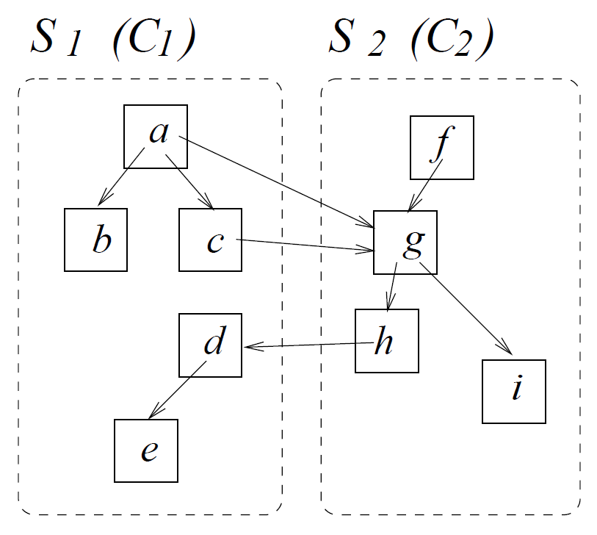
Static Assignment
Handling Inter-partition links
Firewall
No communication overhead, no overlap
Possibly missed pages, poor quality
Cross-over
No communication overhead, good coverage
Overlap possible, still bad quality
Exchange
No overlap, good coverage, high quality
Some communication overhead required

Slide 7
Exchange Mode
Batch communication - wait until many inter-partition links are discovered and send out as a group
Reduced network load
Replication - store n most popular URLs in each C-proc and ignore them when encountered (unless they are in your partition)

Slide 8
Partitioning Methods
URL-hash - Entire URL hashed and assigned to a C-proc
http://www.homestarrunner.com/sbemail.html
Site-hash - Based on host domain
www.cnn.com
www.odu.edu
Hierarchical
www.*.com
www.*.net

Slide 9
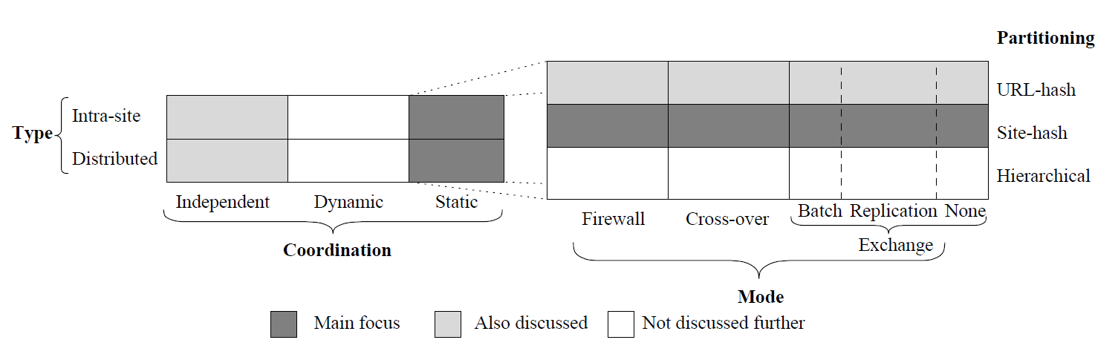
Summary

Slide 10
Experiment Description
40 million websites
Downloaded with Stanford WebBase crawler in 1999 over a 2 week period
Seeded with Open Directory (www.dmoz.org) URLs
Totaled around 1 million seed pages

Slide 11
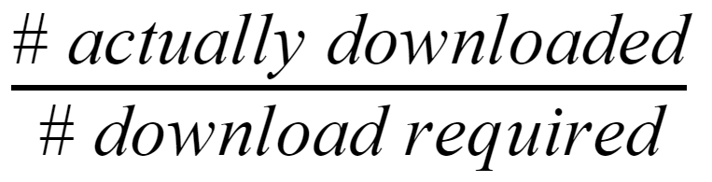
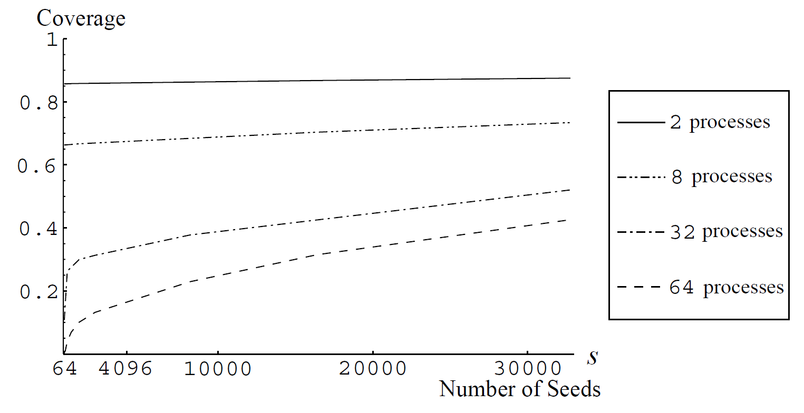
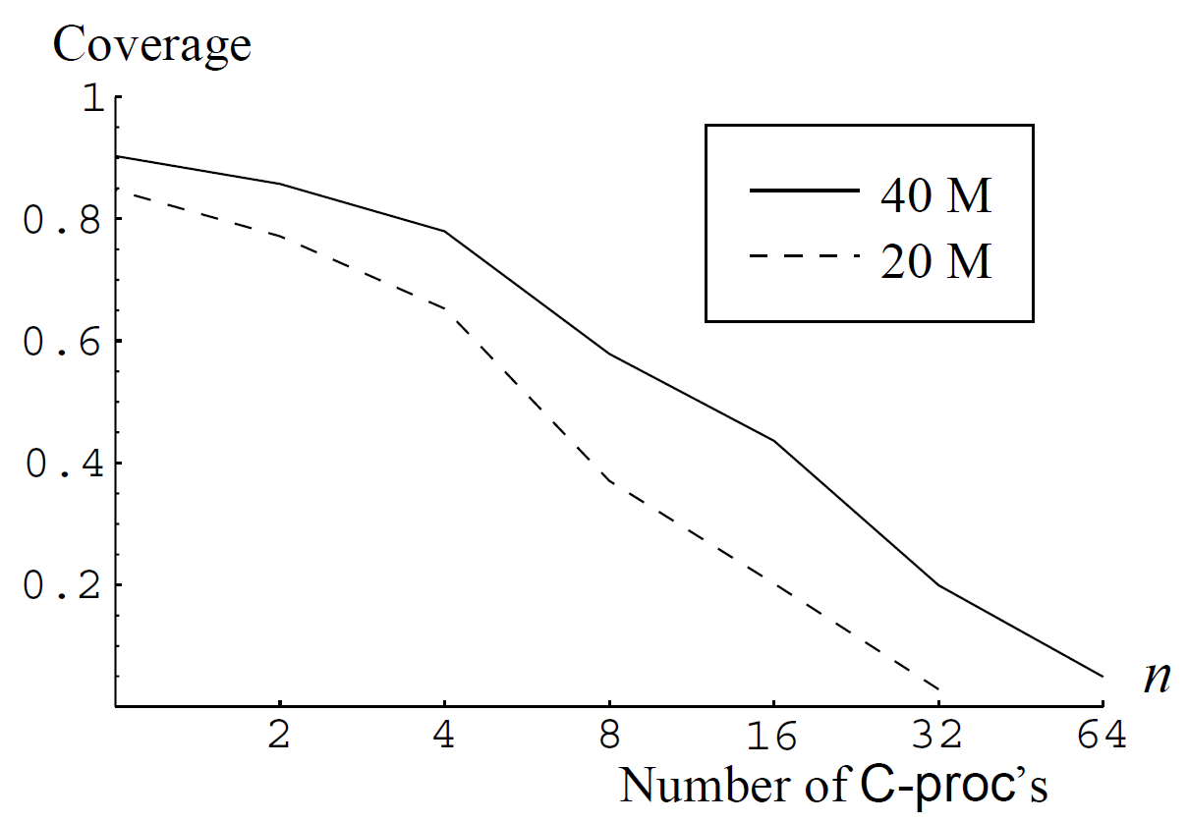
Firewall Mode Evaluation
Coverage

Slide 12
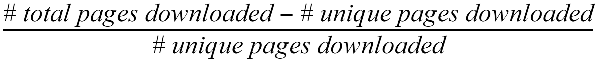
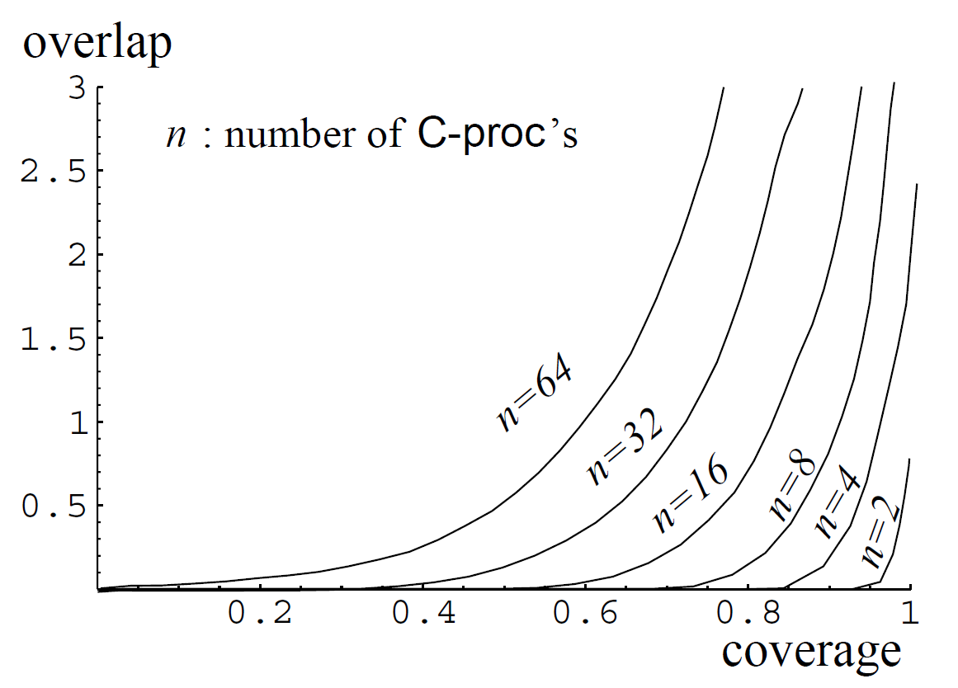
Crossover Mode - Overlap vs Coverage
Overlap
Coverage

Slide 13
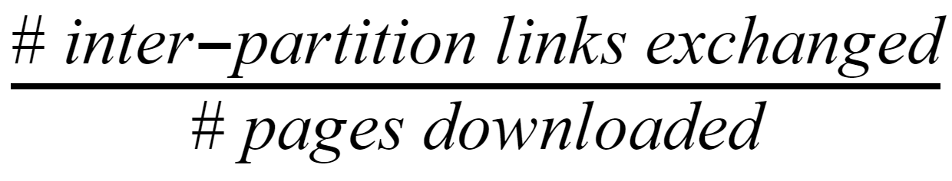
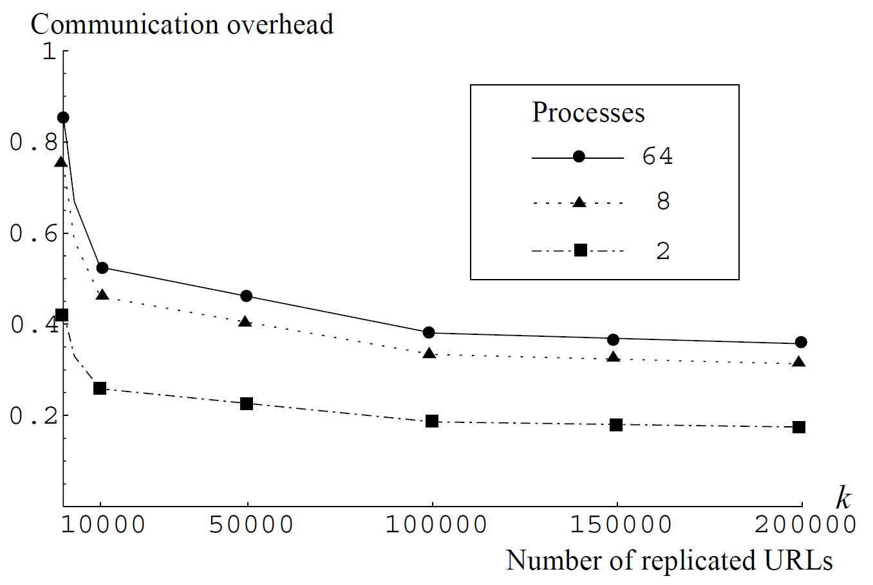
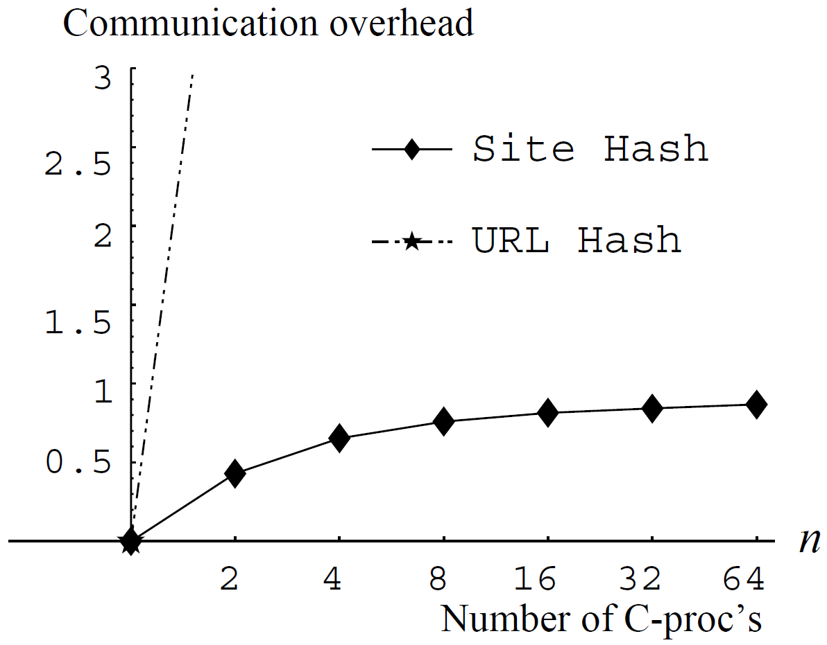
Exchange Mode
Communication Overhead

Slide 14
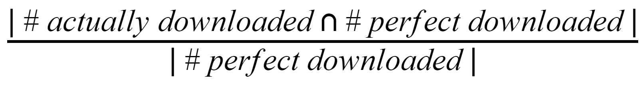
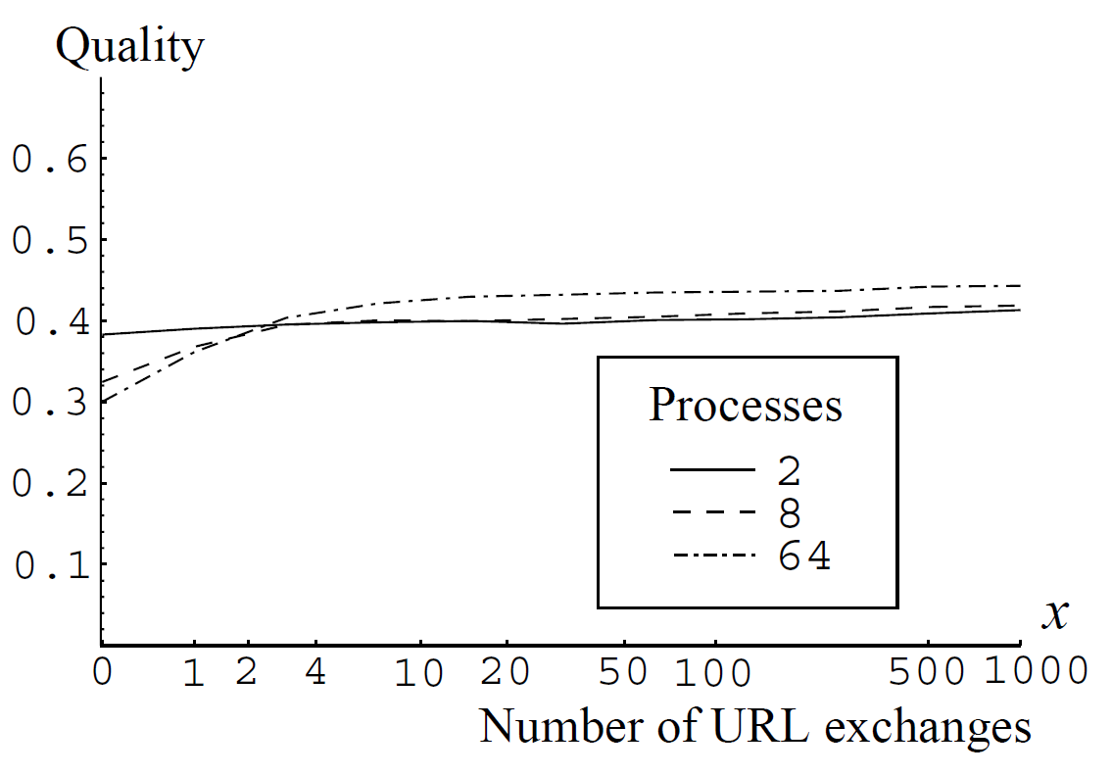
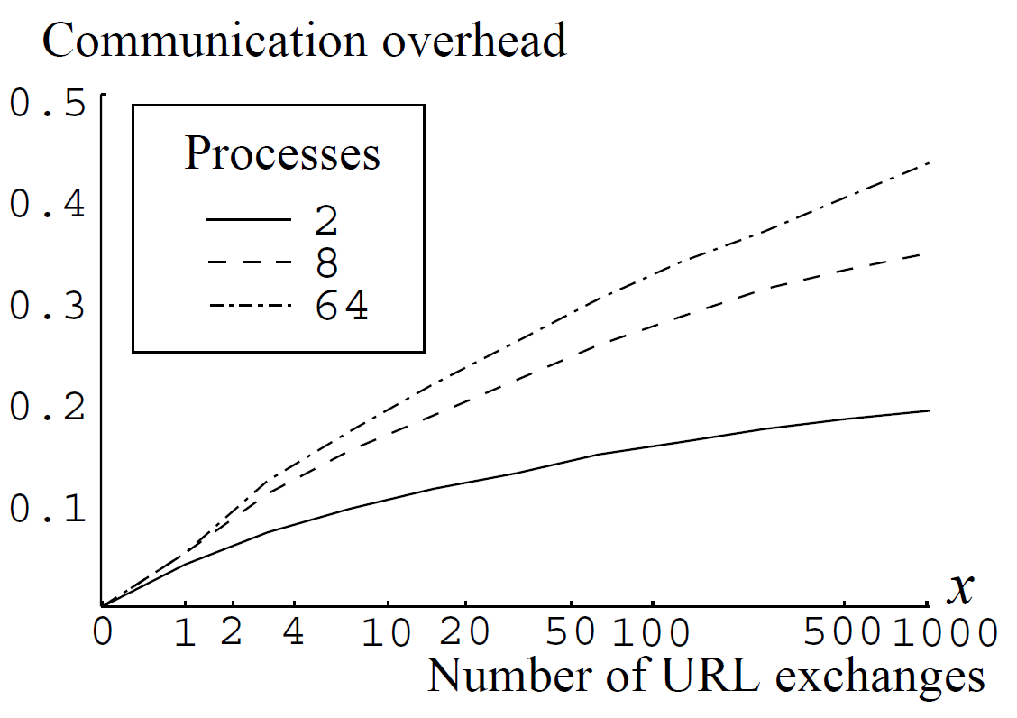
Exchange Mode
Quality

Slide 15
Conclusions
Small number of crawlers (less than 4) in firewall mode provide good coverage
If we need more than 4 crawlers firewall mode will lose coverage
If quality matters firewall mode is a bad choice
URL exchange consumes around 1% bandwidth for communication overhead
Exchange mode maximizes quality, even with exchanging backlink messages less than 100 times during entire crawl
Replicating URLs reduced communication overhead by about 40% while not significantly affecting overhead

Slide 16
Parallel Crawlers
Junghoo Cho, Hector Garcia-Molina Proceedings of the 11th International Conference on World Wide Web. ACM, 2002.
Efficient URL Caching for WWW Crawling
Andrei Broder, Marc Najork, and Janet L. Wiener Proceedings of the 12th International Conference on World Wide Web. ACM, 2003.
Presented by Matt Chaney
CS 834 - Presentation 1

Slide 17
Recall Web Crawler Algorithm
Fetch a page
Parse it to extract all URLs
For each unique, not-yet-encountered URL from 2, repeat steps 1-3.

Slide 18
Why caching?
Non-uniformity of requests
Not all web pages were created equal
Temporal correlation / Locality of Reference
Current requests are likely to be needed again soon
Links on same page likely to be repeated (30% are duplicates)
Cache Strategy
Store popular pages
Store recent pages

Slide 19
Mercator
Parallel crawler
Host-based URL hashing
Exchange mode to maximize coverage
Exchanges in batches to reduce communication overhead
Minimizes overlap with a cached URL collection

Slide 20
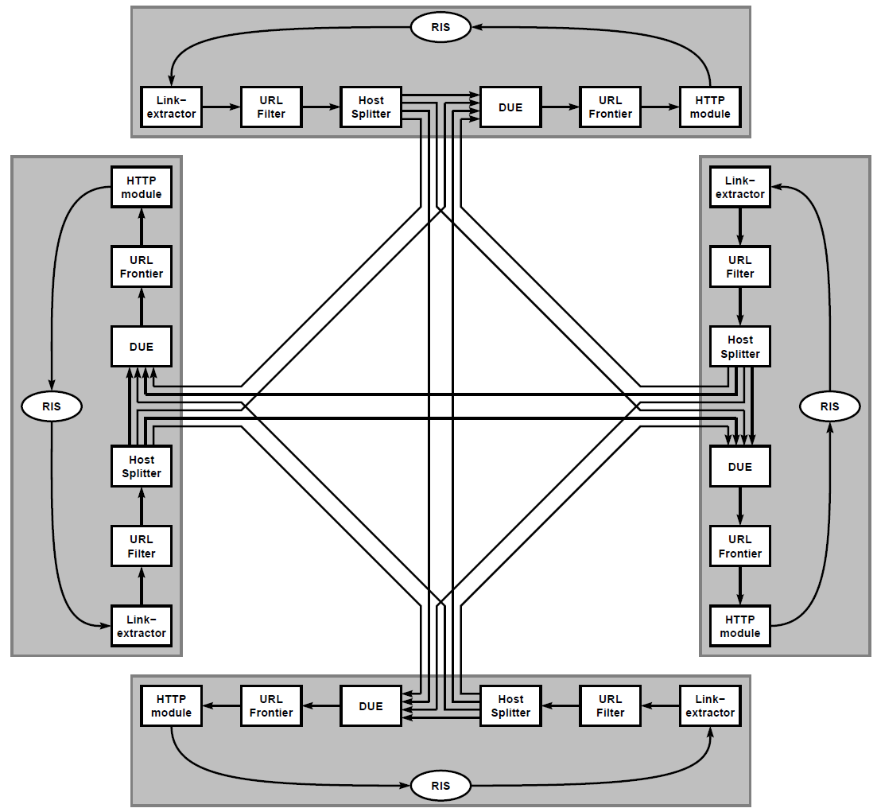
Mercator
Notes:
Obtain URL from frontier
Download HTML into a buffer, called RewindInputStream (RIS)
Extract all links from the page in RIS buffer
Filter out undesirable URLs from this list
Feed URLs into Host Splitter to assign each to a crawl process
All received URLs from Host Splitter run through Duplicate URL Eliminator (DUE)
Add remaining URLs added to the frontier

Slide 21
Eviction Selection
Infinite size cache
Clairvoyant (MIN)
Evict the request that is the furthest away in time
Least Recently Used (LRU)
Evict the oldest item in the cache
CLOCK
Array with mark-bit, pointer to spot following last eviction
Got a new item?
In cache → mark it
Not in cache → follow items, turning mark bits off, until unmarked item is found
Random replacement
Static
Pre-load cache with n most popular URLs

Slide 22
Algorithm Implementations
In all cases a hash table is used
Separate structure used for each cache item for eviction victim selection
Implementation | Data Structure
Random | List
Clock | List + Clock handle + mark bit / item
LRU | Heap sorted on last used time
Static | None; static doesn’t evict
MIN | Heap sorted on next use time

Slide 23
Experiment Description
Four Compaq XP1000 workstations
667 Mhz processor
1.5 GB RAM
144 GB HDD
100 Mbit/sec Ethernet
Ran from July 12 to September 3, 2002
1.04 billion download attempts, 784 million successful
429 million of these were web pages
26.83 billion links
Average 62.55 links/page
Median was only 23

Slide 24
Datasets
Full Trace - All URLs assigned to a particular machine
Cross Sub-Trace - URLs discovered by one machine that another machine is responsible for
Each trace was fed into each of the 5 mentioned implementations
Infinite, Clairvoyant (MIN), LRU, CLOCK, and Static
In total, about 1,800 separate experiments run

Slide 25
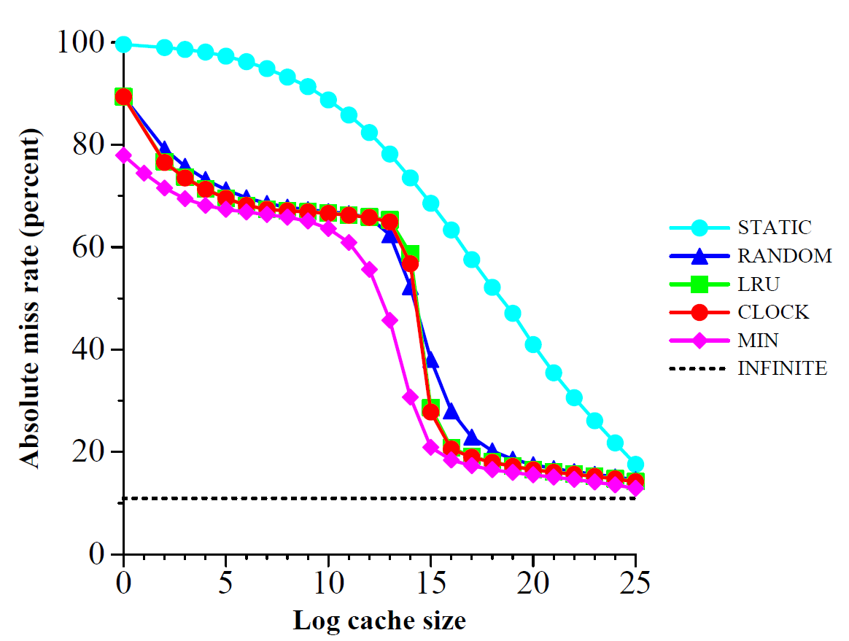
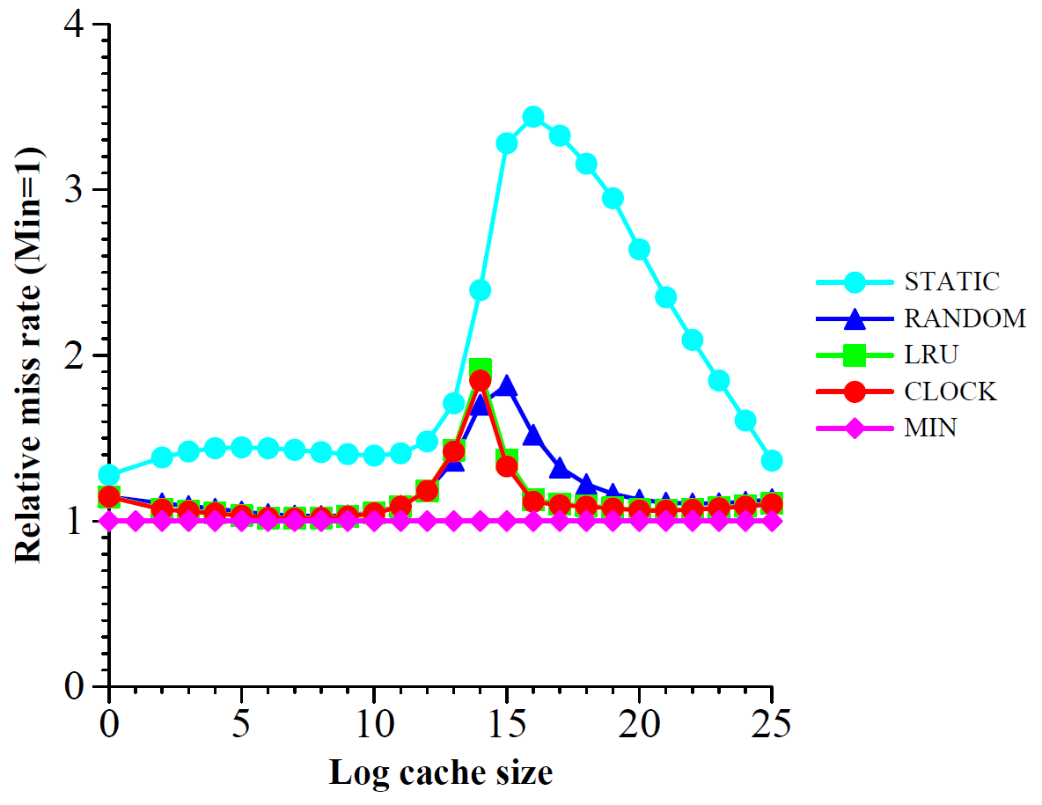
Results

Slide 26
Conclusions
URL caching is very effective
A cache of roughly 50,000 entries achieved a hit rate of 80%
There is a “sweet spot”
A significantly smaller cache is not effective
A significantly larger cache does not provide much tangible benefit
Locality of Reference confirmed
Static showing generally terrible results
LRU and CLOCK showing good results
Critical Region observed for cache sizes from 2¹⁴ to 2¹⁸

Slide 27
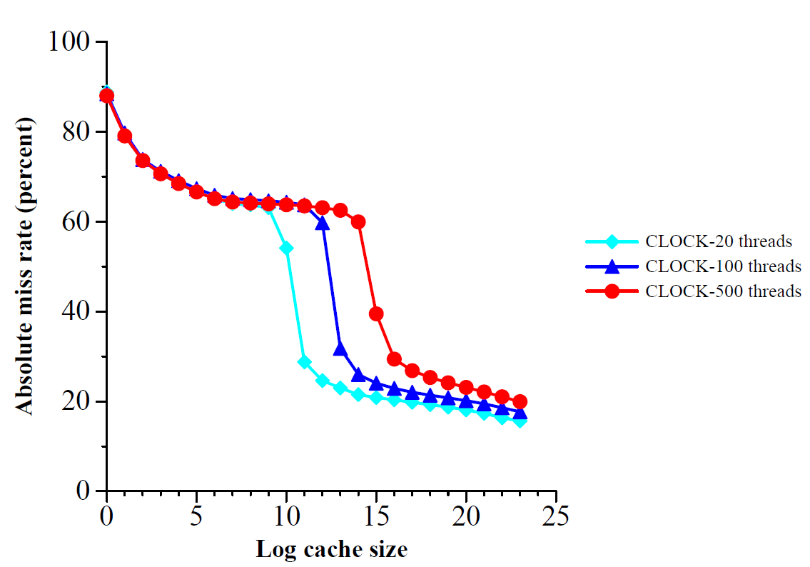
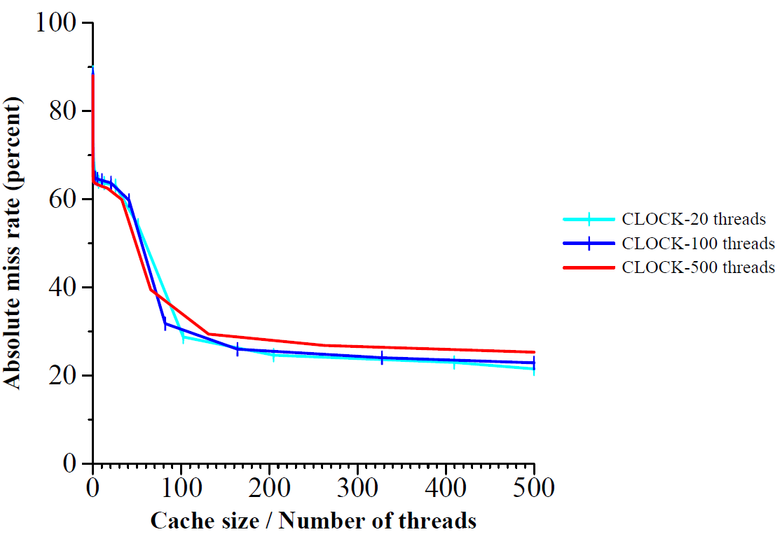
Results

